Slide 1



SIMATS ENGINEERING Saveetha Institute of Medical and Technical Sciences Chennai-602105.
Development of a Banking Ledger System with Automated Interest Calculation
CSA0212- C Programming
Presented by:
Gayathri B R(192521330) Nanditha S(192412467)
P V Karishmika (192511453)
Supervisor: Dr. V. Karpagam

Slide 2

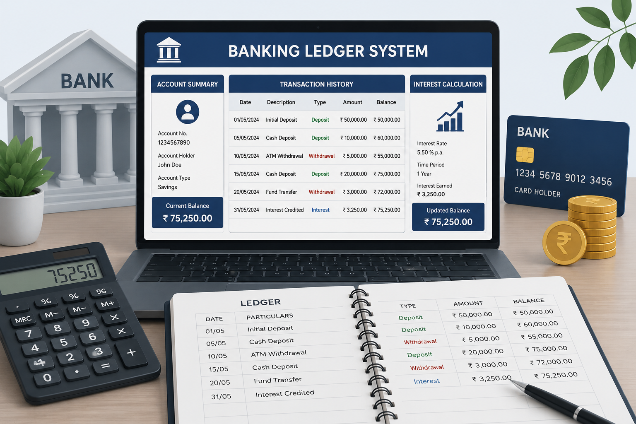
Introduction
A Banking Ledger System is a software application developed using the C programming language to manage customer bank accounts efficiently. It records customer details, maintains account balances, performs banking transactions, and automatically calculates interest, reducing manual effort and improving accuracy.

Slide 3

Objectives
Develop a computerized banking ledger system.
Store customer account information securely.
Perform deposit and withdrawal transactions.
Automatically calculate interest on account balances.

Slide 4
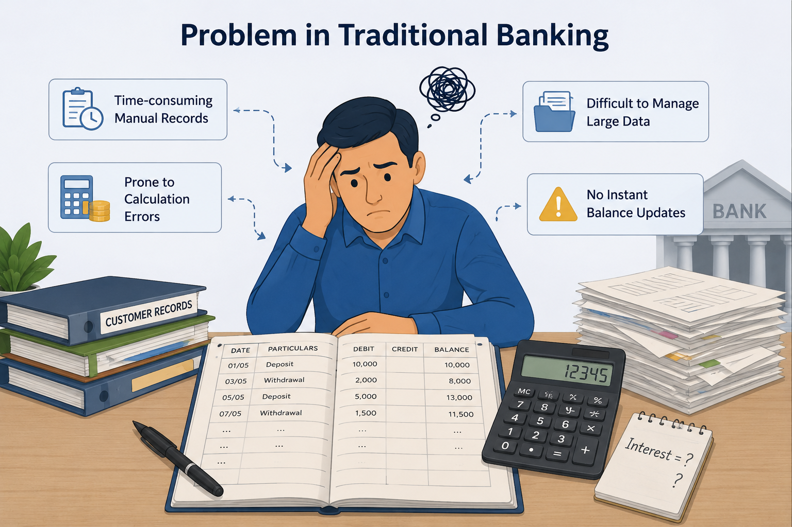
Problem Statement
Manual banking records are time-consuming and prone to errors.
Interest calculation is often inaccurate when done manually.
Managing customer accounts and transactions efficiently is difficult.
An automated C-based banking ledger system is needed for accurate and efficient account management.

Slide 5
MODULES
Module 1: Customer Account Management
Create and manage customer accounts by storing personal details and initial account information.
Module 2: Banking Transaction Processing
Perform banking operations such as deposits, withdrawals, and balance inquiries while updating the ledger.
Module 3: Automated Interest Calculation & Report Generation
Calculate interest automatically based on the account balance and generate the updated account summary for the customer.

Slide 6
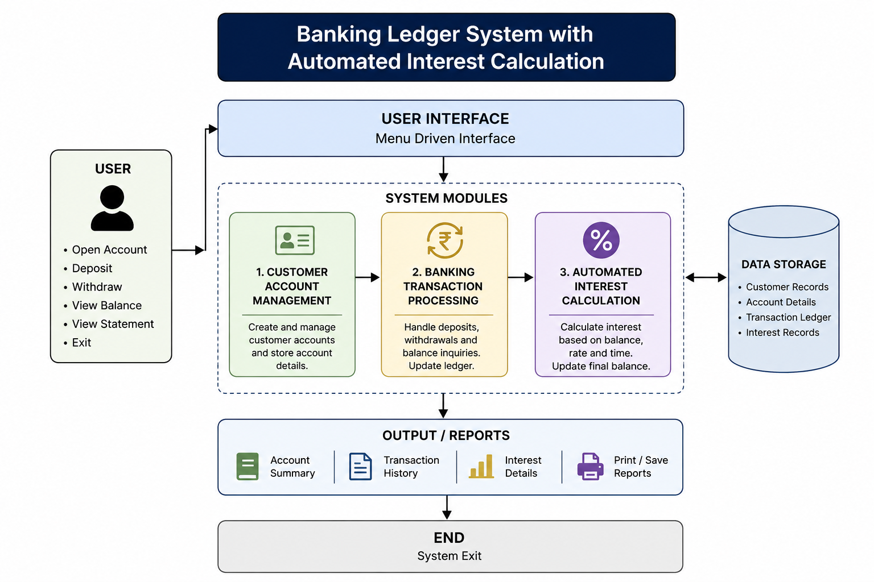
Block Diagram

Slide 7
Conclusion
The Banking Ledger System simplifies banking operations by automating customer account management and interest calculation. The project demonstrates the practical application of C programming concepts such as structures, functions, file handling, and decision-making, making banking operations more efficient and reliable.

Slide 8

Thank
you

Slide 9
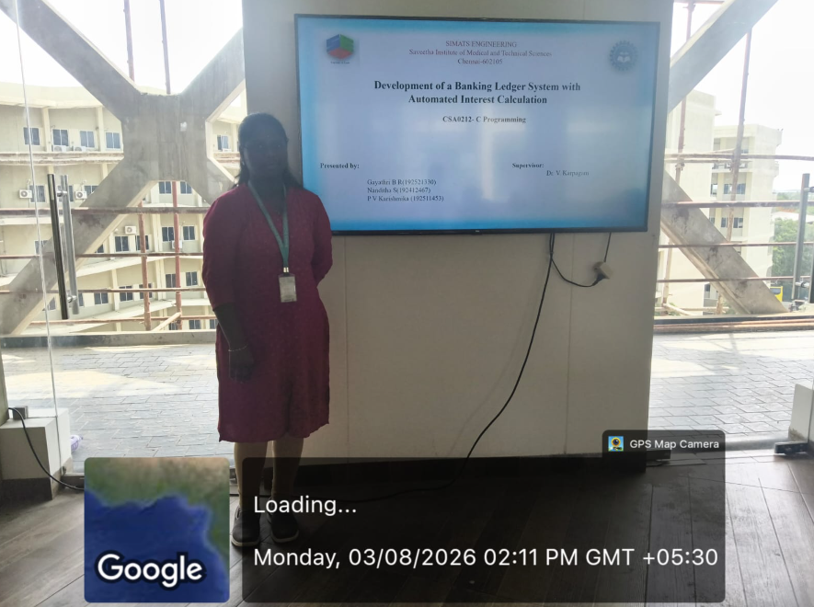
Geotag

